Slide 1



K. J. Somaiya College of Science and Commerce
Re-Accredited ‘A’ Grade by NAAC
Autonomous- Affiliated to University of Mumbai
Awarded Best College under Urban Category in 2010
National Board for Higher Mathematics
sponsored workshop on
BASIC COMPLEX ANALYSIS
February 1-6, 2016
Organized by K. J. Somaiya College of Science and Commerce
in
Collaboration with The Department of Mathematics
University of Mumbai

Slide 2
BASIC COMPLEX ANALYSIS
FEBRUARY 1-6, 2016
About the College
The Somaiya Vidyavihar is committed to the cause of Education, Community Service, Indian Culture and Research in Science and technology. Padmabhushan Param Pujya (late) Shri. Karamshibhai Jethabhai Somaiya, an entrepreneur, philanthropist and visionary established Somaiya Vidyavihar, a sprawling campus of 60 acres at Vidyavihar and 35 acres at Sion, Mumbai in the year 1959. Somaiya trust houses 34 different institutions dedicated in the streams of arts, sciences, management, engineering, medicine, humanities, philosophies and social sciences. Somaiya Vidyavihar also runs a few autonomous postgraduate courses, vocational training courses and high schools within its campus as well as in rural India.
The K.J. Somaiya College of Science and Commerce, affiliated to the University of Mumbai was awarded 'A' grade by NAAC in February 2004 and re-accredited with 'A' Grade in September 2010 by NAAC. The college was adjudged the Best College of the University of Mumbai in 2010 in Urban category. The college recently has been conferred Autonomous Status for a period of five years commencing from 2013-2014.
The college strives to achieve excellence in disseminating education. In recent years the college has received the prestigious FIST and DBT’s Star college grant. The grant received has helped the college to undertake many promising projects in reality.

Slide 3
BASIC COMPLEX ANALYSIS
FEBRUARY 1-6, 2016
University of Mumbai has introduced for the first time Complex Analysis course in the TYBSc syllabus.
Objectives of the workshop are
To understand the scope of the syllabus.
To help undergraduate teachers review
the syllabus and support smooth implementation of the course.
Venue: Seminar Hall, 1st floor
K. J. Somaiya College of Science and Commerce
Registration Fees: Rs. 600
Registration at the venue on 1st February 2016 from 9.00 am to 10.00 am

Slide 4
BASIC COMPLEX ANALYSIS
FEBRUARY 1-6, 2016
Resource persons:
Prof. Dr. Jyotshana V. Prajapat
Head, Department of Mathematics, University of Mumbai
Prof. Dr. Hemsunder, SIWS College
Schedule:
10.00 am-11.30 am LECTURE
11.30 am -11.45 am TEA BREAK
11.45 am -12.45 pm TUTORIAL
12.45 pm- 1.30 pm LUNCH BREAK
1.30 pm – 3.00 pm LECTURE
3.00 pm – 3.15 pm TEA BREAK
3.15 pm- 4.15 pm TUTORIAL

Slide 5
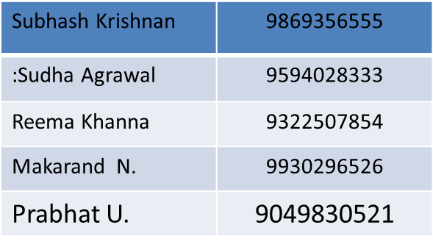
BASIC COMPLEX ANALYSIS
FEBRUARY 1-6, 2016
Hostel Charges :
A/C room: Rs. 1500 per day ( twin sharing)
Rs. 2000 per day (single occupancy)
Non A/C rooms:
Rs.1000 per day ( twin sharing)
Rs. 1500 per day (single occupancy)
For any query contact : math.somaiya@gmail.com

Slide 6
BASIC COMPLEX ANALYSIS
FEBRUARY 1-6, 2016
Duly filled registration form should reach along with demand draft in favor of
Principal, K. J. Somaiya College of Science and Commerce, payable at Mumbai,
should be forwarded to The Principal,
K. J. Somaiya College of Science and Commerce, Vidyavihar, Mumbai 400077.
Participants can send the duly filled forms along with the DD by courier or speed post or through mail.
Last date for sending the registration form is 25th January 2016.
Mark the envelope in bold letter “WORKSHOP-COMPLEX ANALYSIS”

Slide 7
PATRONS
Shri. Samir Somaiya
(President, Somaiya Vidyavihar)
Smt. Leelaben Kotak Shri V. Ranganathan Dr. Rajan Welukar . (Trustee ) (Hon. Secretary) (Provost)
Organising Committee
Chairperson
Dr. Vijay Joshi
(Principal)
Subhash Krishnan
(Dean Administration and Students Welfare)
Dr. Jyotshana V. Prajapat
(Head, Department of Math, University of Mumbai)
Sudha Agrawal Reema Khanna Makarand Niphadkar Prabhatkumar Upadhyay

Slide 8
BASIC COMPLEX ANALYSIS
FEBRUARY 1-6, 2016
Contact details: K. J. Somaiya College of Science and Commerce, Vidyavihar East, Mumbai 400077
Tel(91-22)21025919 Fax(91-22)21024918
Email: math.somaiya@gmail.com
Visit us at www.somaiya.edu/kjssc
Directions:
Nearest Railway:
Central Railway: Vidyavihar, Ghatkopar
Harbour Railway: Chembur, Lokmanya Tilak nagar
Metro: Ghatkopar
Outstation: LTT
One can travel by auto rickshaw from these stations.
Walk able distance from Vidyavihar.

